Slide 1
Oop- Object Oriented programming
Presented by: Md. Kamrul Hasan
Date: 20-10-2020

Slide 2
Content:
Why OOP? Slide No:3
What is OOP? Slide No:4
Basic features of OOP. Slide No:5
What is Abstraction? Slide No:6
Can we have abstract class without having any abstract method? Slide No:8
Can we have sealed Method in abstract class? Slide No:9
Difference between Abstract & Interface Slide No:10
What is Encapsulation? Slide No:11
Difference between Abstraction & Encapsulation. Slide No:12
What is inheritance? Slide No:13
What is Polymorphism? Slide No:15
What is difference between Overloading & Overriding? Slide No:21
What is Static Class & Method? Slide No:22
How can you prevent your class to be inherited further? Slide No:26
Difference between class & Structure. Slide No:27
What are the access modifier? Slide No:28
Can you override private virtual method? Slide No:29
What is shadowing or hiding? Slide No:30
Difference between namespace & Assembly. Slide No:31
What are generics? Slide No:32
What is a Delegate & Event? Slide No:34
Can we have multiple Main Method in one .cs file? Slide No:35
What is the default access modifier of a class? Slide No:36
How does composition mechanism works? Slide No:37
Can you prevent your class from being inherited & becoming a base class for some other classes? Slide No:38
Can you allow class to be inherited, but prevent the method from being overridden? Slide No:39
Why can’t you specify the accessibility modifier for methods inside the interface? Slide No:40
Static data members should be initialized inside the constructor. True or false? Slide No:41

Slide 3

Why OOP?
To Make software projects more manageable and predictable
Easier to model real things.
Faster and easier to execute.
Provides clear structure for the programs.
To create full reusable application with less
code and shorter development time.

Slide 4
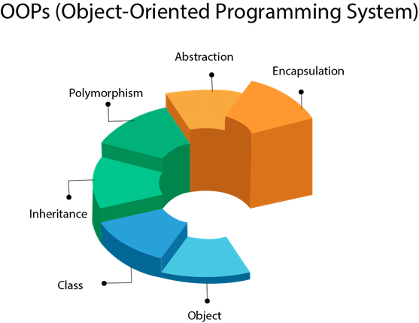
What is OOP?
Procedural programming is about writing procedures or functions
that perform operations on the data, while object-oriented
programming is about creating objects that contain both data
and functions.
Object oriented programming is (OOP) is a programming
technique in which programs are written on the basis of object

Slide 5
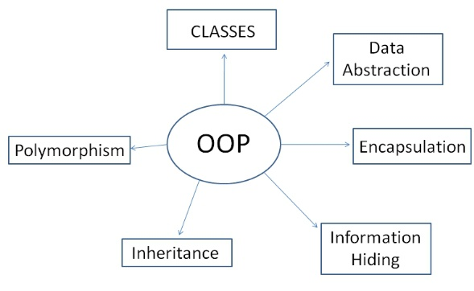
basic features of OOPs
The basic features of Object-Oriented programming are:
Inheritance
Polymorphism
Data Hiding
Encapsulation
Overloading
Reusability

Slide 6
What is Abstraction?
Data abstraction is the process of hiding certain details and showing only essential information to the user.
The abstract keyword is used for classes and methods:
Abstract class: is a restricted class that cannot be used to create objects (to access it, it must be inherited from another class). Abstract method: can only be used in an abstract class, and it does not have a body. The body is provided by the derived class.
To access the abstract class, it must be inherited from another class.

Slide 7
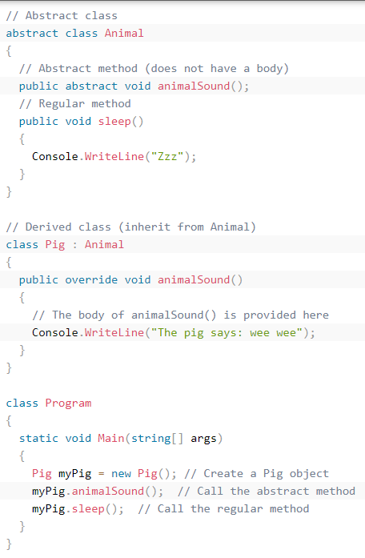
See this example :

Slide 8
Can we have abstract class without having any abstract method?
Yes, we can have an abstract class without Abstract Methods as both are independent concepts.
Declaring a class abstract means that it cannot be instantiated on its own and can only be sub classed.
Declaring a method abstract means that Method will be defined in the subclass.
You can see this java example: https://www.tutorialspoint.com/compile_java8_online.php
You can learn more about Abstract class & Method from this link: https://www.c-sharpcorner.com/UploadFile/93126e/importance-and-use-of-versioning-in-C-Sharp/

Slide 9
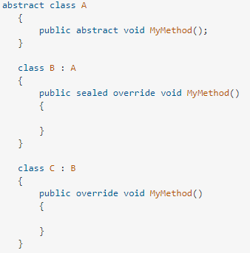
Can we have sealed Method in abstract class?
It is an error to use the abstract modifier with a
sealed class,
Because, an abstract class must be inherited by a class
that provides an implementation of the abstract methods
or properties.
When applied to a method or property, the sealed modifier
must always be used with override.
Sealed only can be used hand in hand with the
"override" keyword, and stops other classes from
overriding the functions themselves.

Slide 10
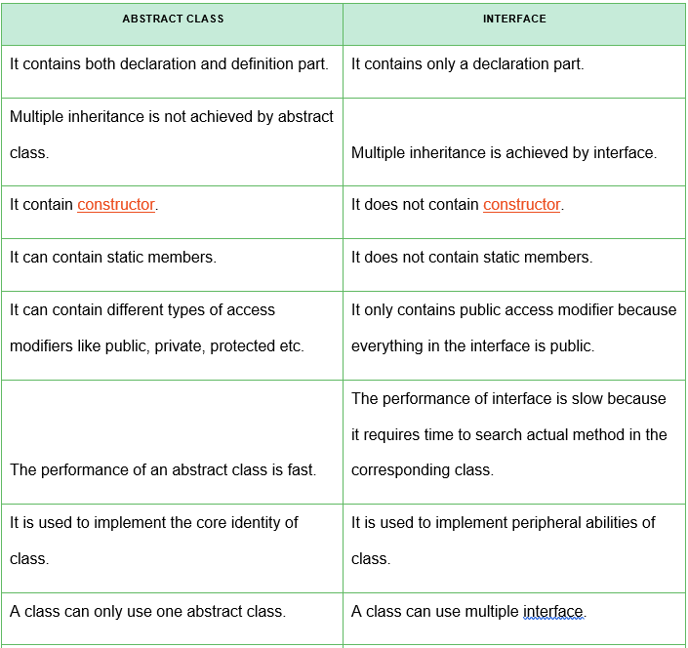
Difference between Abstract & Interface

Slide 11
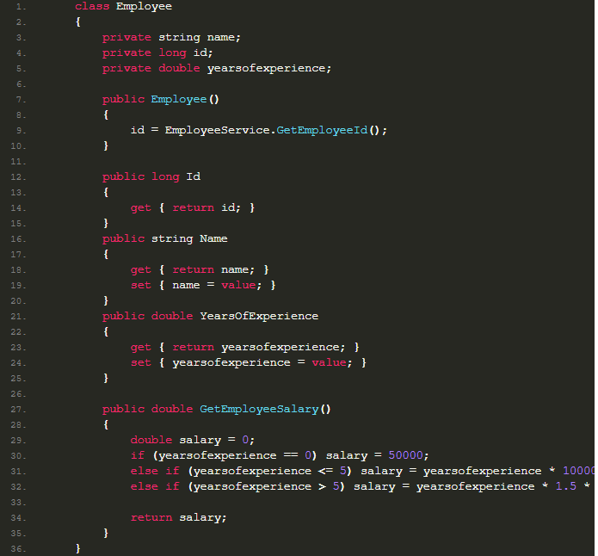
What is Encapsulation?
Encapsulation is the mechanism that bonds together code
and the data it manipulates, and keeps both safe from
outside interference and misuse.
You can implement encapsulation using Access Modifiers
(Public, protected and private)
Encapsulation solves the problem In implementation
level
For simplicity, encapsulation means hiding data using
getter and setter
You can read more details from here:
https://procodeguide.com/programming/oop-concept-encapsulation-in-c-net/

Slide 12
Difference between Abstraction & Encapsulation
Abstraction is about hiding unwanted details while giving out the most essential details, while
Encapsulation means hiding the code and data into a single unit e.g. class or method to protect
the inner working of an object from the outside world.
More details about abstraction: https://www.w3schools.com/cs/cs_abstract.asp

Slide 13
What is inheritance?
Inheritance (Derived and Base Class)
In C#, it is possible to inherit fields and methods from one class to another. We group the "inheritance concept" into two categories:
Derived Class (child) - the class that inherits from another class
Base Class (parent) - the class being inherited from
To inherit from a class, use the : symbol.

Slide 14
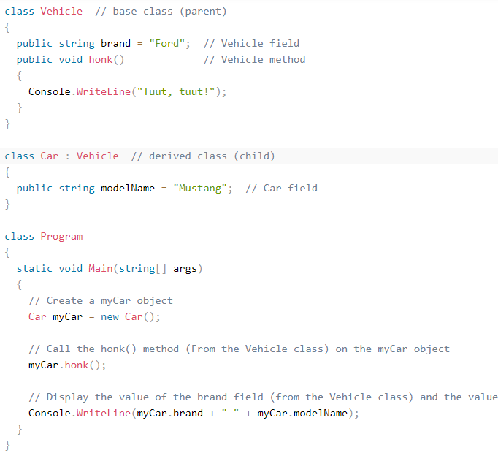
In the example below, the Car class (child) inherits the fields and methods from the vehicles class (parent):

Slide 15
What is Polymorphism?
Polymorphism is a Greek word, meaning "one name many forms". In other words, one object has many forms or has one name with multiple functionalities. "Poly" means many and "morph" means forms. Polymorphism provides the ability to a class to have multiple implementations with the same name. It is one of the core principles of Object-Oriented Programming after encapsulation and inheritance.

Slide 16
There are two types of polymorphism in C#:
Static / Compile Time Polymorphism.
Dynamic / Runtime Polymorphism.

Slide 17
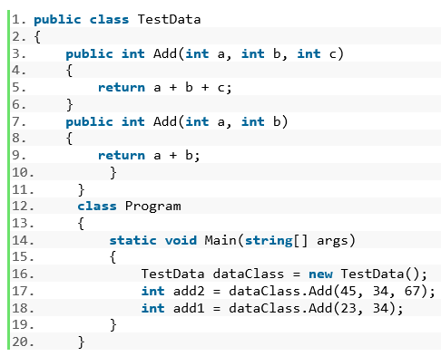
Static or Compile Time Polymorphism:
It is also known as Early Binding. Method overloading is an example of Static Polymorphism.
In overloading, the method / function has a same name but different signatures.
It is also known as Compile Time Polymorphism because the decision of
which method is to be called is made at compile time. Overloading is the concept in
which method names are the same with a different set of parameters.
In the following example, a class has two methods with the same name "Add" but
with different input parameters (the first method has three parameters and the second
method has two parameters).

Slide 18
Dynamic / Runtime Polymorphism
Dynamic / runtime polymorphism is also known as late binding. Here, the method name and the method signature (number of parameters and parameter type must be the same and may have a different implementation). Method overriding is an example of dynamic polymorphism.
Method overriding can be done using inheritance. With method overriding it is possible for the base class and derived class to have the same method name and same something. The compiler would not be aware of the method available for overriding the functionality, so the compiler does not throw an error at compile time. The compiler will decide which method to call at runtime and if no method is found then it throws an error.

Slide 19
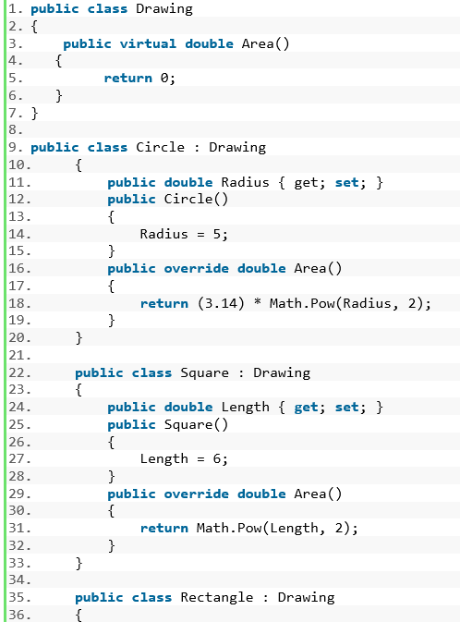
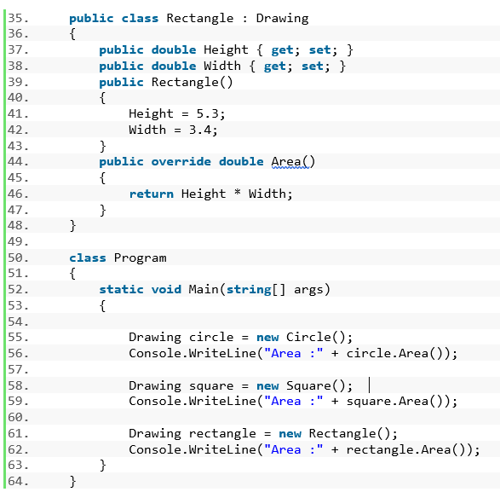
Example of Dynamic / Runtime Polymorphism:

Slide 20
Summary of Dynamic / Runtime Polymorphism:
The meaning of Polymorphism is one name having multiple forms.
The following are the two types of Polymorphism:
Static or compile-time polymorphism (for example, method overloading and operator overloading).
Dynamic or runtime polymorphism (for example, overriding).
Method Overriding differs from shadowing.
Using the "new" keyword, we can hide the base class member.
We can prevent a derived class from overriding virtual members.
We can access a base class virtual member from the derived class.

Slide 21
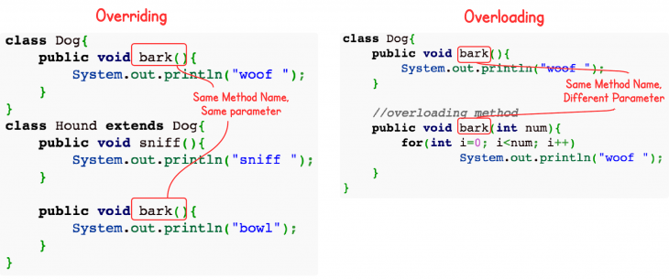
What is difference between Overloading & Overriding?
Overloading occurs when two or more methods in one class have the same method name but different parameters.
Overriding means having two methods with the same method name and parameters (i.e., method signature). One of the methods is in the parent class and the other is in the child class.

Slide 22
What is static class and method?
A C# static class is a class that can't be instantiated. The sole purpose of the class is to provide blueprints of its inherited classes. A static class is created using the "static" keyword in C#. A static class can contain static members only. You can‘t create an object for the static class.

Slide 23
Advantages of Static Classes
If you declare any member as a non-static member, you will get an error.
When you try to create an instance to the static class, it again generates a compile time error, because the static members can be accessed directly with its class name.
The static keyword is used before the class keyword in a class definition to declare a static class.
A static class members are accessed by the class name followed by the member name.

Slide 24
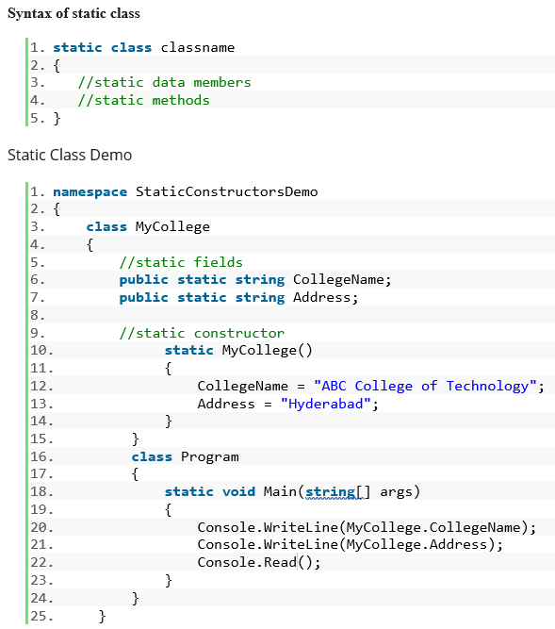
Syntax of static class & Demo:

Slide 25
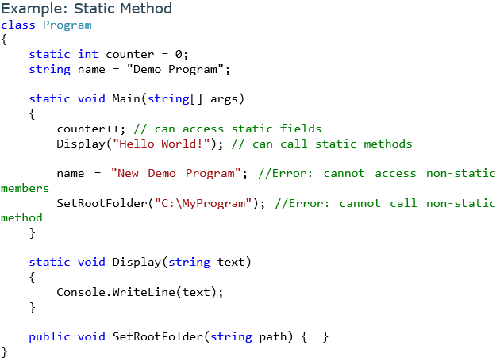
Static Methods
You can define one or more static methods in a
non-static class. Static methods can be called without
creating an object. You cannot call static methods using
an object of the non-static class.
The static methods can only call other
static methods and access static members. You cannot
access non-static members of the class in the static
methods.

Slide 26
How can you prevent your class to be inherited further?
In order to prevent a class in C# from being inherited, the keyword sealed is used. Thus, a sealed class may not serve as a base class of any other class. It is also obvious that a sealed class cannot be an abstract class.

Slide 27
Difference between class & Structure
Difference between Structs and Classes:
Structs are value type where as Classes are reference type.
Structs are stored on the stack whereas Classes are stored on the heap.
Value types hold their value in memory where they are declared,
But reference type holds a reference to an object memory.

Slide 28
What are the access modifiers?
Control the visibility of class members (the security level of each individual class and class member).

Slide 29
Can you override private virtual method?
You can't declare private virtual methods because there's no point (since there'd be no way to override them). But you can override protected virtual methods. You won't fund your private method in your derivative class. So, the virtual keyword has no sense in this case.
Moreover, you cannot access private methods in inherited classes. - They have to be protected in the base class to allow any sort of access.

Slide 30
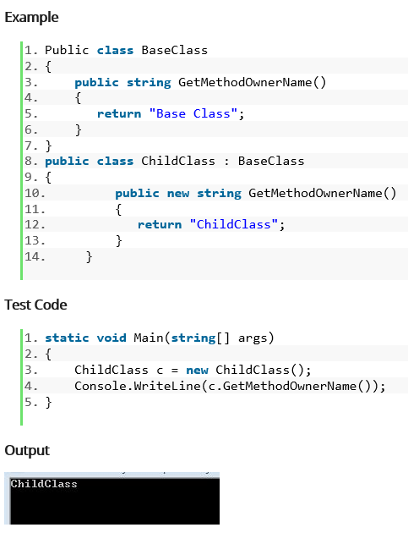
What is shadowing or hiding?
A method or function of the base class is available to the
child (derived) class without the use of the "overriding"
keyword. The compiler hides the function or method of
the base class. This concept is known as shadowing
or method hiding.

Slide 31
Difference between namespace & Assembly.
A .NET Namespace provides the fundamental unit of logical code grouping while an assembly provides a fundamental unit of physical code grouping.
Namespaces is a logical group of related classes that can be used by any other language targeting the Microsoft. Net framework.
Namespace: 1) it is a Collection of names wherein each name is Unique. 2) They form the logical boundary for a Group of classes. 3) Namespace must be specified in Project-Properties.
Assembly: 1) It is an Output Unit. 2) It is a unit of Deployment & a unit of versioning. 3) Assemblies contain MSIL code. 4) Assemblies are Self-Describing. [e.g. metadata, manifest]

Slide 32
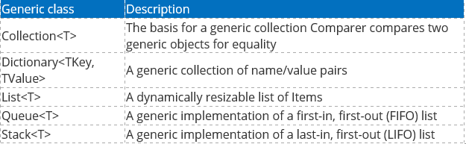
What are generics?
Generics allow you to write a class or method that can work with any data type
Generic Classes: The Generic class can be defined by putting the <T> sign after the class name. It isn't mandatory to put the "T" word in the Generic type definition. You can use any word in the TestClass<> class declaration.
The System.Collection.Generic namespace also defines a number of classes that implement many of these key interfaces. The following table describes the core class types of this namespace.

Slide 33
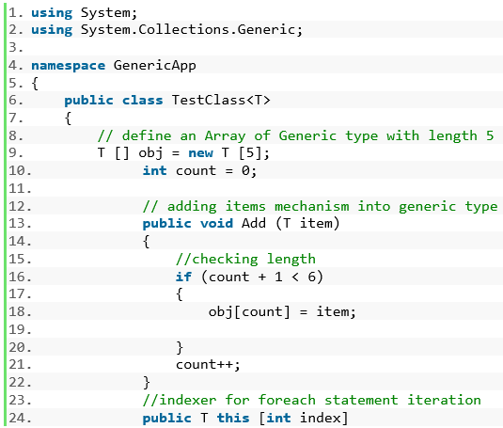
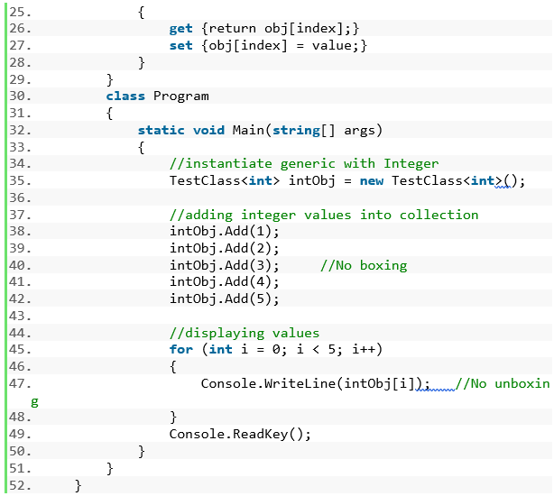
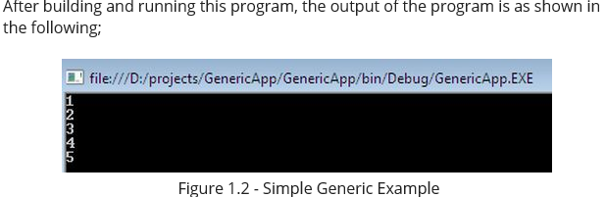
Simple Generic Class Example

Slide 34
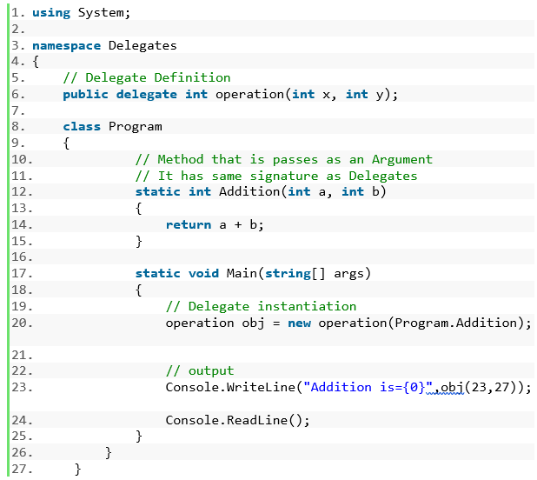
What is a delegate and event?
A delegate is a way of telling C# which method to call
when an event is triggered. For example, if you click
a Button on a form, the program would call a specific
method. It is this pointer that is a delegate. ...
An event is a notification by the .NET framework that
an action has occurred.
More Details::
https://www.c-sharpcorner.com/UploadFile/84c85b/delegates-and-events-C-Sharp-net/

Slide 35
Can we have multiple Main Method in one .cs file?
Yes, we can have Multiple Main Methods in one .cs file. The crux is we can have multiple classes in one .cs file and we can define one main methods in each class.

Slide 36
What is the default access modifier of a class?
Internal
Class and struct accessibility
Internal is the default if no access modifier is specified. Struct members, including nested classes and structs, can be declared public , internal , or private .

Slide 37
How does composition mechanism works?
This mechanism helps to simplify a complex problem into an easier problem. It generally makes different classes and objects to communicate with each other and thus making the problem solved. It communicates with the problem by making different classes and objects to send a message to each other.

Slide 38
Can you prevent your class from being inherited & becoming a base class for some other classes?
You can't declare private virtual methods because there's no point (since there'd be no way to override them). But you can override protected virtual methods. You won't fund your private method in your derivative class. So, the virtual keyword has no sense in this case.
Moreover, you cannot access private methods in inherited classes. - They have to be protected in the base class to allow any sort of access.

Slide 39
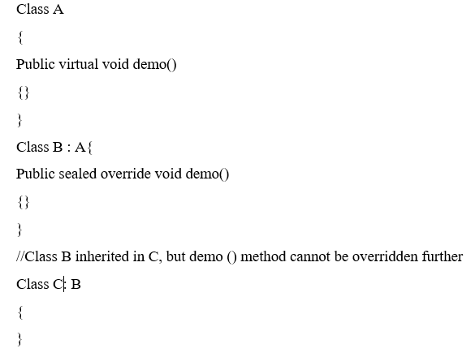
Can you allow class to be inherited, but prevent the method from being overridden?
Yes, put 2 modifiers before the method sealed override.

Slide 40
Why can’t you specify the accessibility modifier for methods inside the interface?
An Interface defines the public methods that must appear on any class that implements that interface. The reason for this is that other classes will consume that interface and those classes would not have access to private or protected methods, and therefore would not care about them.

Slide 41
Static data members should be initialized inside the constructor. True or false?
False!
Static member variables are not associated with each object of the class. It is shared by all objects. If you initialize in constructor then it means that you are trying to associate with a particular instance of class. Since this is not possible, it is not allowed.

